Slide 1
Automated Riverine Waste Detection Using Random Forest and Multispectral Satellite Imagery
Máté Cserép, Botond Dénes, Zoltán Vincellér
{mcserep, jwdnzy, vzoli}@inf.elte.hu
FOSS4G Europe, Timișoara, 2026.06.30.

Slide 2
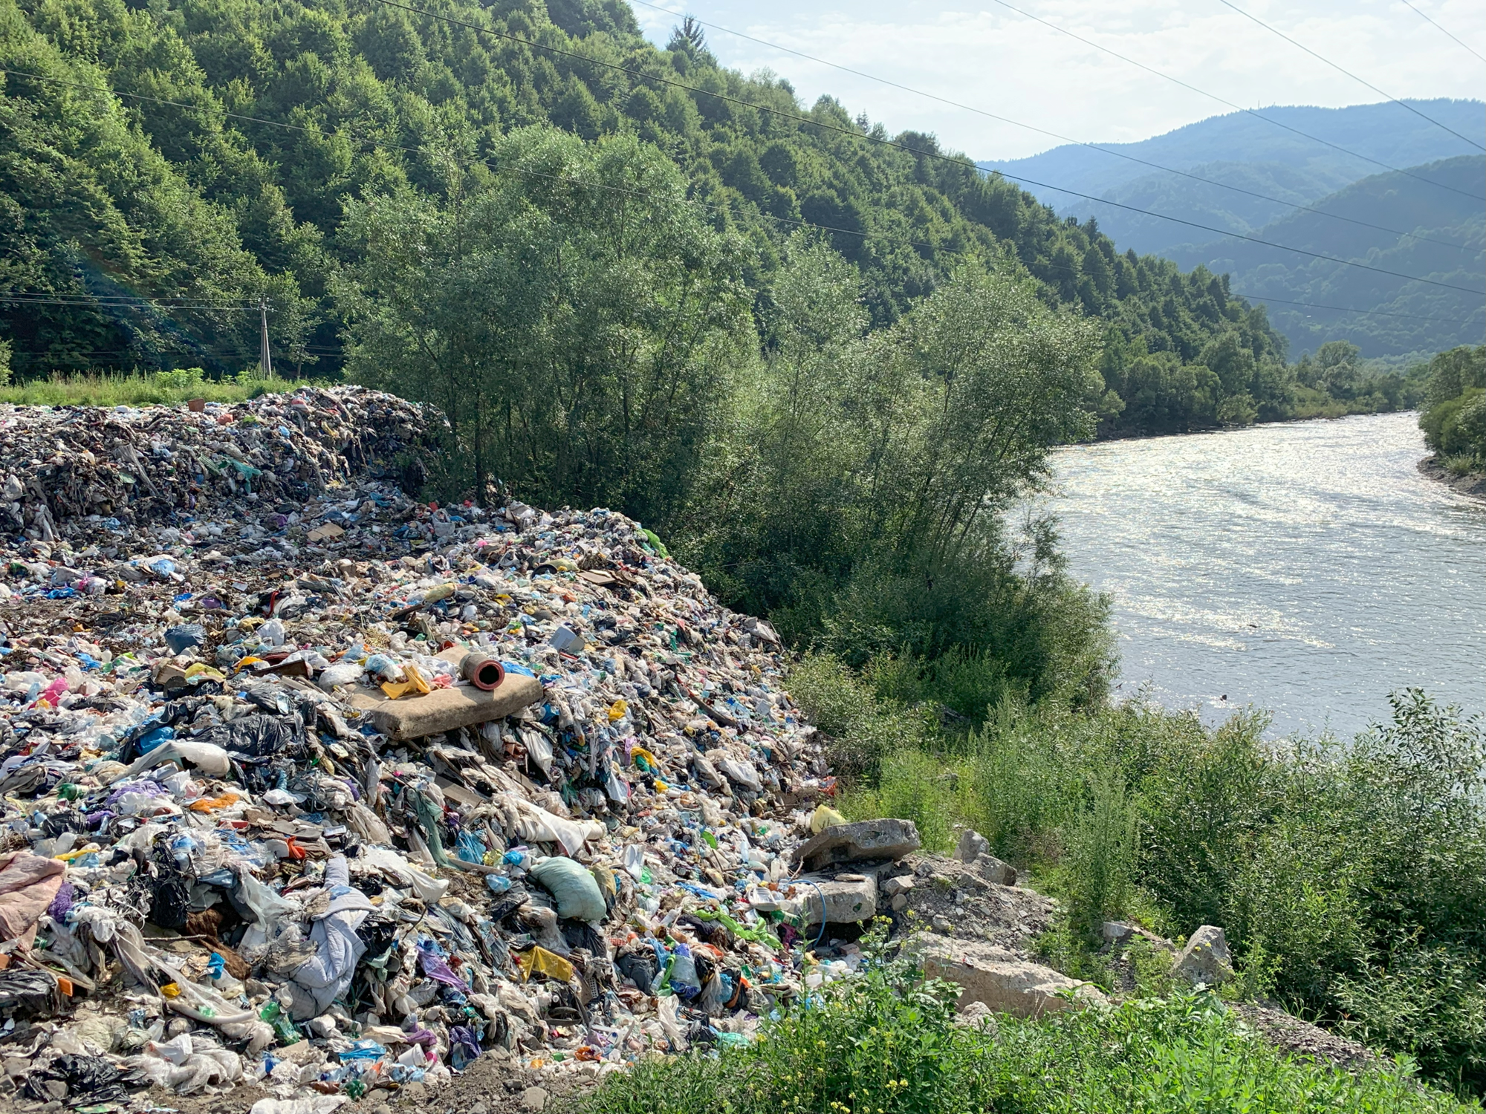
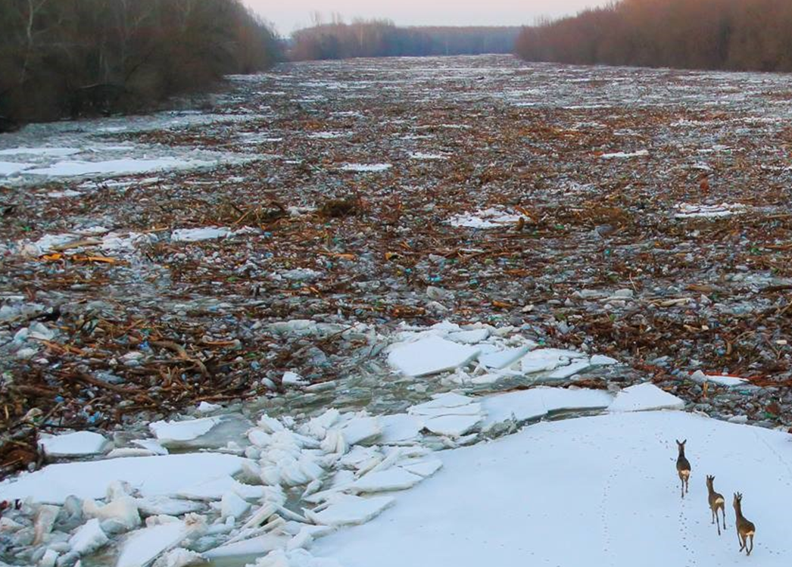
Motivation
Location: Rakhiv, Tisza River, Ukraine
Source: Plastic Cup Initiative
Location: Tisza River, Hungary
Source: Nyírdrón
FOSS4G Europe, Timișoara, 2026.06.30.
Notes:
Tisza: Ukraine, Romania, Hungary, Serbia
Drainage basin also extends into Slovakia

Slide 3
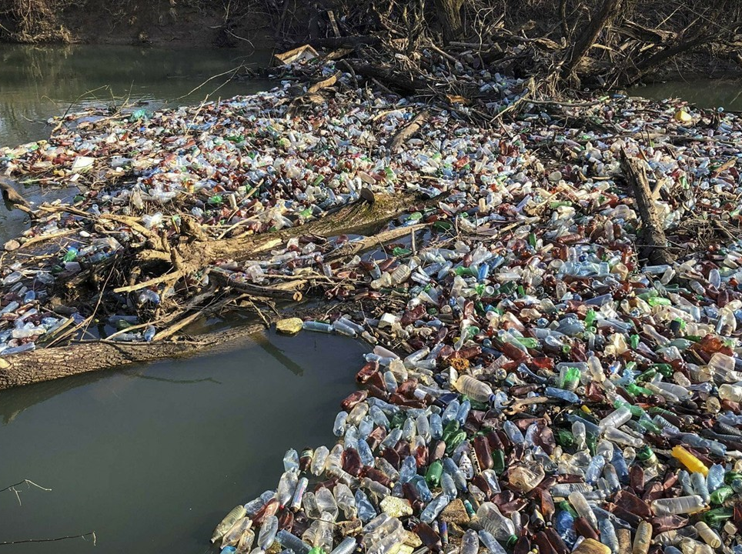
Objectives
Identify hotspots, e.g. illegal waste deposits near rivers
Identify riverine litter accumulations on the water surface
FOSS4G Europe, Timișoara, 2026.06.30.

Slide 4
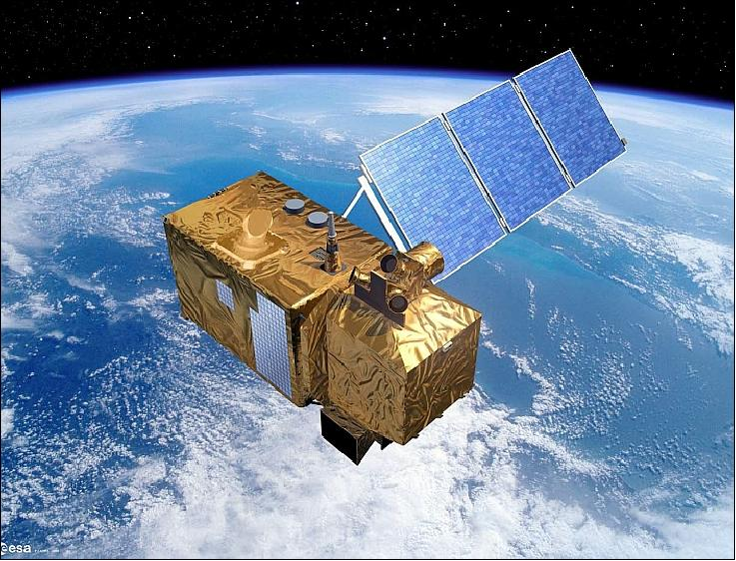
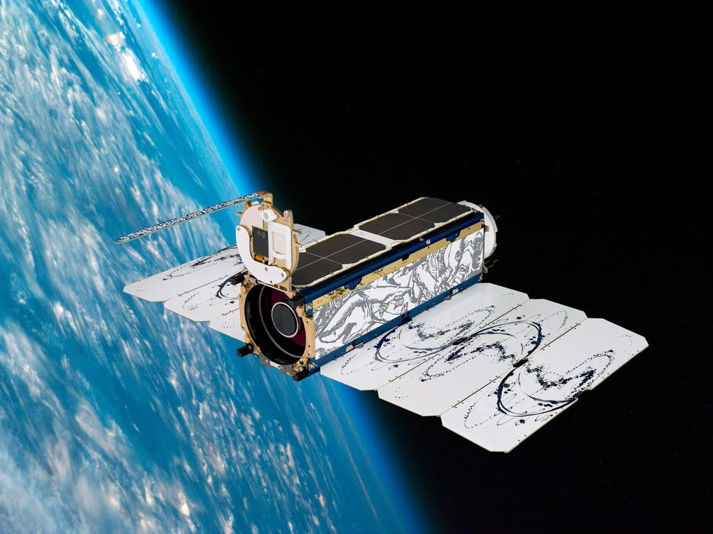
DATA SOURCES
Sentinel-2
Spatial resolution: 10-20-60 m
Spectral resolution: 13 bands
Revisit time: 5 days
PlanetScope
Spatial resolution: 3 m
Spectral resolution: 4 bands
Revisit time: 1 day
FOSS4G Europe, Timișoara, 2026.06.30.

Slide 5
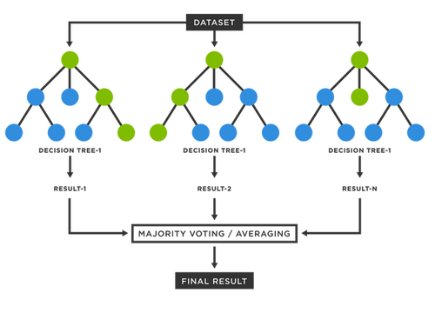


PRIMARY METHOD: RANDOM FOREST
Machine learning based method
Well-known and simple
Requires less training data
Classification
Intensity values of spectral bands
Spectral indices:
  NDVI, RNDVI, NDWI, SR, etc.
  PI (Plastic Index)
  API (Adjusted Plastic Index)
$$PI = \frac{NIR}{NIR + RED}$$
$$NDVI = \frac{NIR − RED}{NIR + RED}$$
$$MNDBI = \frac{SWIR − NIR}{SWIR + NIR}$$
$${API}_{1} = \left\{\begin{matrix}PI − NDVI & if NDVI > 0 \\ PI & otherwise\end{matrix}\right.$$
$${API}_{2} = \left\{\begin{matrix}{API}_{1} − MNDBI & if MNDBI > 0 \\ {API}_{1} & otherwise\end{matrix}\right.$$
FOSS4G Europe, Timișoara, 2026.06.30.
Notes:
PI: defined in 2020
API: defined in 2023

Slide 6
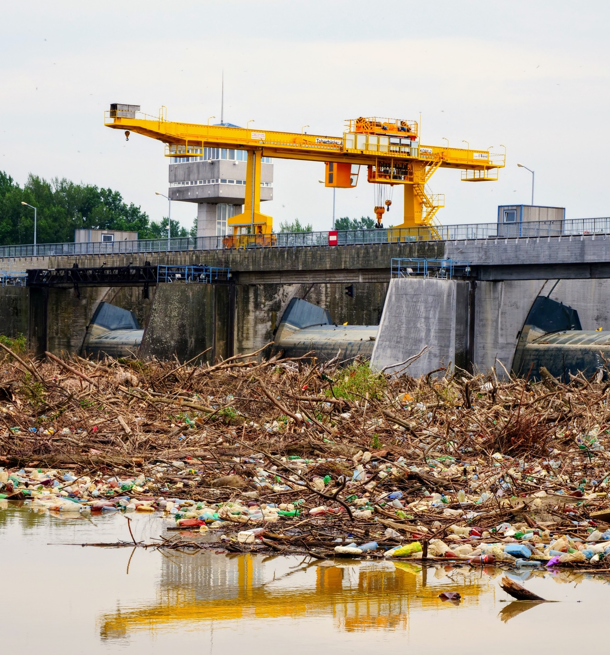
TRAINING DATA
Training locations:
29 legal landfills and their surroundings in Romania
Kisköre Hydroelectric Power Plant
in Hungary
Training dataset:
PlanetScope satellite imagery
  3 meter / pixel spatial resolution
  27 million pixels of training data
FOSS4G Europe, Timișoara, 2026.06.30.

Slide 7
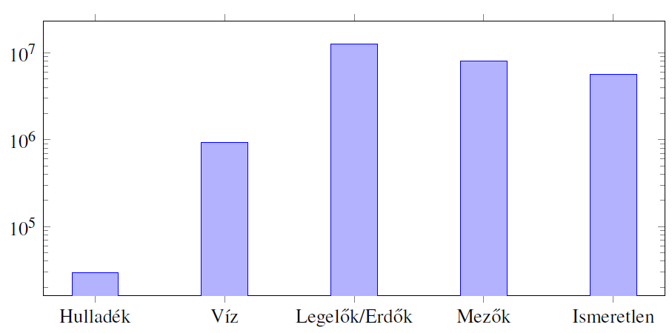
MODEL TRAINING – LABEL WEIGHTING
Challenge #1:
The amount of waste in the training data is significantly smaller
compared to the other classes
Weighting according to the distribution of the training data
Waste
Water
Forest / Pasture
Field
Unknown
FOSS4G Europe, Timișoara, 2026.06.30.

Slide 8
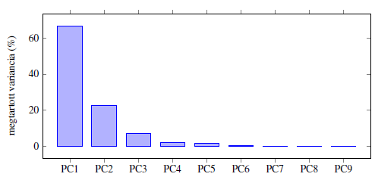
MODEL TRAINING – PRINCIPAL COMPONENT ANALYSIS
Challenge #2:
Model size can be quite large (~14GB) due to high number of dimensions
Dimensionality reduction with principal component analysis (to ~2GB)
Explained variance (%)
FOSS4G Europe, Timișoara, 2026.06.30.

Slide 9
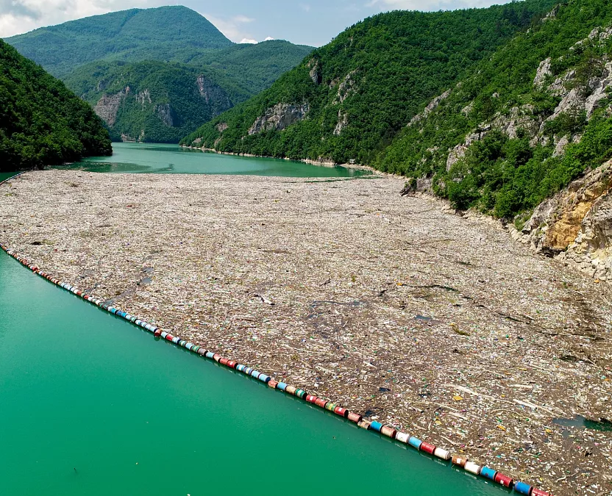
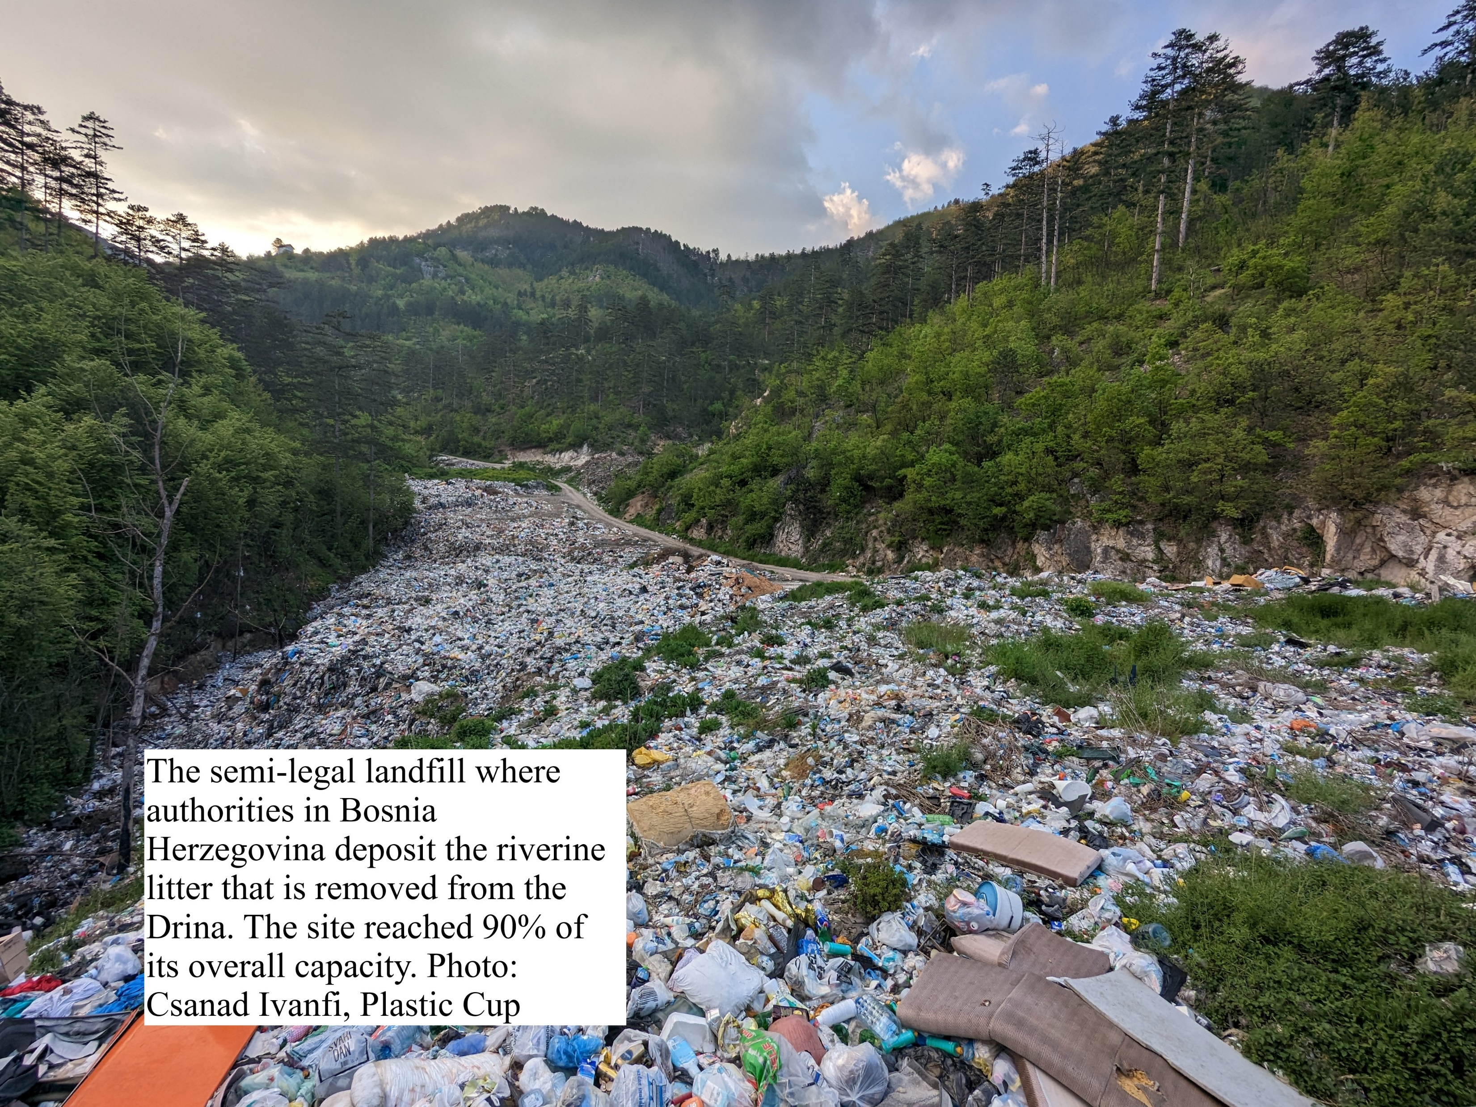
VALIDATION SITE
The validation site was the Drina River at Višegrad, Bosnia and Herzegovina.
Source: Euronews
FOSS4G Europe, Timișoara, 2026.06.30.

Slide 10
Numerical evaluatioN
Quantitive evaluation
Performed on 3 satellite images for the validation site
Also trained a model from summer (May-October) images
  Proved the most reliable for the operational objective
 | Baseline RF model | RF model with PCA | RF summer model
Extraction Rate | 41.31 % | 65.25 % | 39.63 %
Match Rate | 29.32 % | 34.99 % | 28.05 %
Commission Rate | 28.13 % | 39.01 % | 26.10 %
Omission Rate | 70.67 % | 65.00 % | 71.27 %
FOSS4G Europe, Timișoara, 2026.06.30.

Slide 11
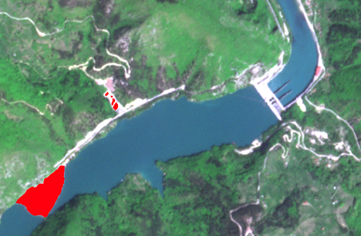
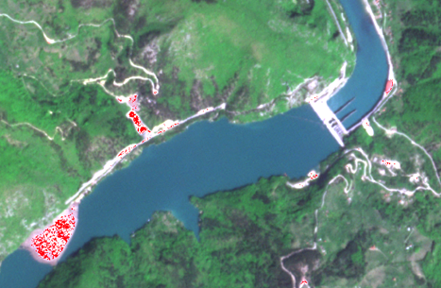
QUALITATIVE Results
Ground truth
Visegrad, Drina, 7 May 2023
Random Forest result
PlanetScope, summer model
FOSS4G Europe, Timișoara, 2026.06.30.

Slide 12
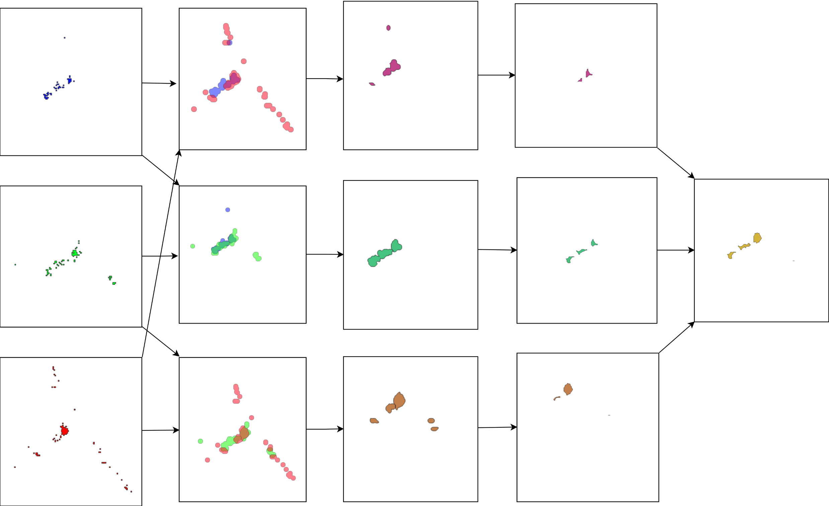
MULTITEMPORAL ANALYIS
Buffer & intersection
Crop intersection
Invert buffer
Epoch #1
Compute union
Epoch #2
Epoch #3
FOSS4G Europe, Timișoara, 2026.06.30.

Slide 13
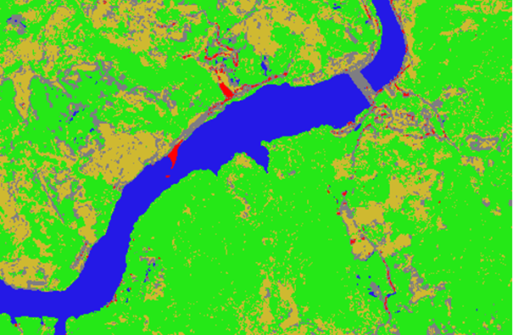
FURTHER APPROACHES
Use Sentinel-2 imagery
65 annotated images
Lower spatial resolution
Higher spectral resolution
  Replace PI with API
Visegrad, Drina, Bosnia-Herzegovina
FOSS4G Europe, Timișoara, 2026.06.30.

Slide 14
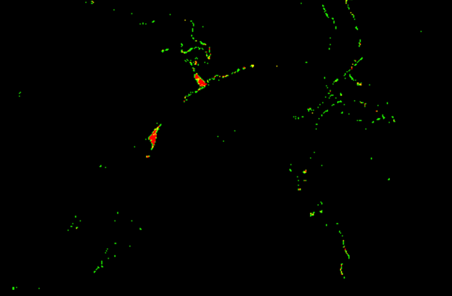
Using Sentinel-2 data and Adjusted Plastic Index
Random Forest result
Sentinel-2, based on API
Detected waste with confidence
FOSS4G Europe, Timișoara, 2026.06.30.

Slide 15
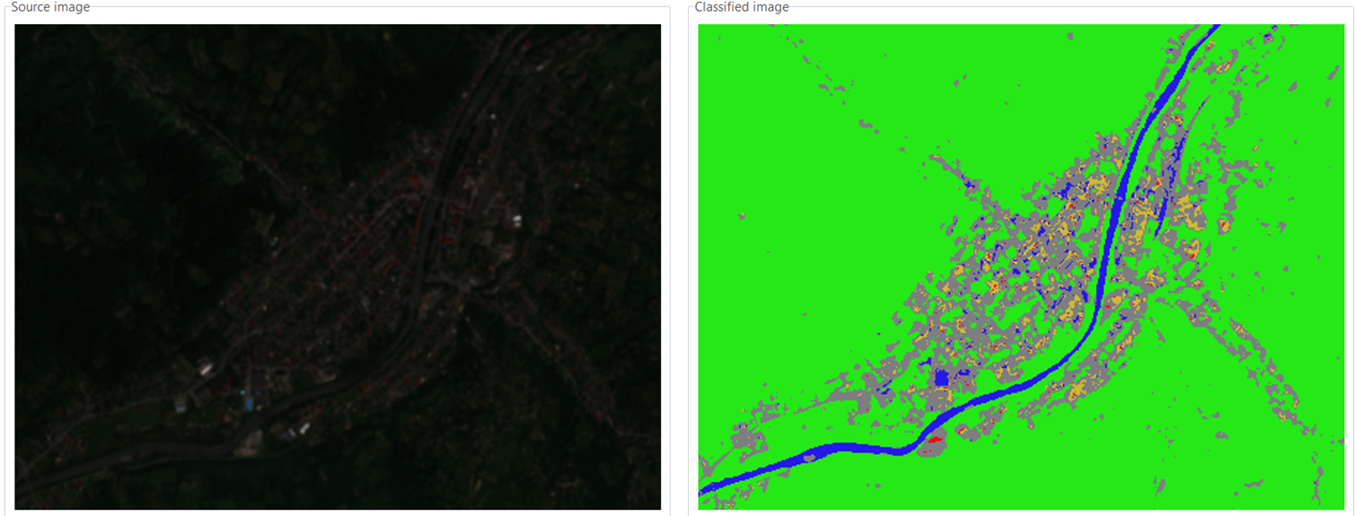
Using Sentinel-2 data and Adjusted Plastic Index
Rakhiv, Tisza, Ukraine
Sentinel-2, based on API
FOSS4G Europe, Timișoara, 2026.06.30.

Slide 16
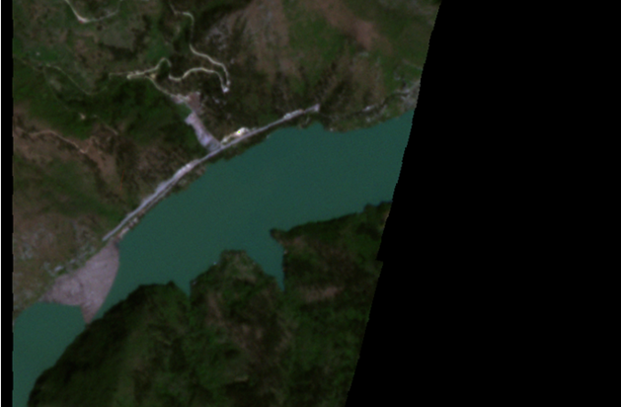
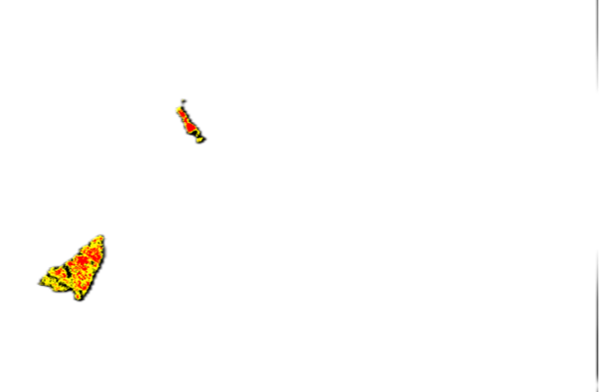
Using U-Net++ CNN
Further ML approaches
Convolutional Neural Networks
  UNET, UNET++
  Training data insufficient for stable, acceptable results
XGBoost
SVM
Visegrad, Drina, Bosnia-Herzegovina
U-NET++ detected waste with confidence
FOSS4G Europe, Timișoara, 2026.06.30.

Slide 17
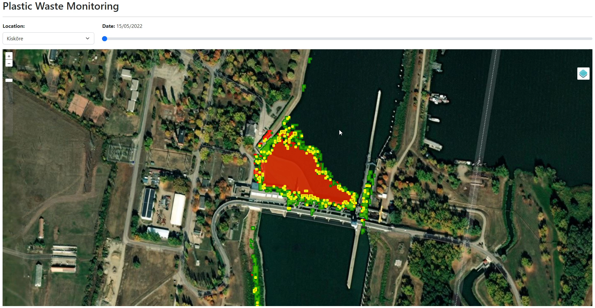
Interactive web demo
https://gis.inf.elte.hu/waste-detection/
FOSS4G Europe, Timișoara, 2026.06.30.

Slide 18
Summary
Development of a classification method for plastic waste detection
  Based on machine learning approaches: Random Forest, U-NET++, etc.
Development of a framework for repeatable and cost-effective monitoring
  Accelerating the detection of illegal landfills near rivers and floating waste accumulations on rivers
  Supporting waste collection campaigns with an automated monitoring system in cooperation with the Plastic Cup Initiative
Open source: https://github.com/GISLab-ELTE/WasteDetection
Ongoing research:
  Application of the Local Binary Pattern (LBP) – a technique known from CV – for detecting plastic waste when supplemented with neighborhood features
  Examining methods that can be used to correct the imbalance in the applied RF
  Integration of hydrological data and forecasting
FOSS4G Europe, Timișoara, 2026.06.30.

Slide 19
Previous publications
A. Molnár, K. Málnás, S. Bőhm, M. Gyalai-Korpos, M. Cserép, T. Kiss: Comparative Analysis of Riverine Plastic Pollution Combining Citizen Science, Remote Sensing and Water Quality Monitoring Techniques, Sustainability, vol. 16 (12), art. 5040, 2024. DOI: 10.3390/su16125040
A. Molnar, K. Málnás, M. Gyalai-Korpos, M. Cserép: Monitoring Coastal Riverine Litter Accumulations in the Tisza River Basin, In Proceedings of the 5th World’s Large Rivers Conference, Wien, Austria, 2023.
D. Magyar, M. Cserép, Z. Vincellér, A. Molnár: Waste Detection and Change Analysis based on Multispectral Satellite Imagery, In Proceedings of KEPAF, art. 53., p. 18., 2023. DOI: 10.48550/arXiv.2303.14521
FOSS4G Europe, Timișoara, 2026.06.30.

Slide 20
Thanks for your attention!
Questions?
Máté Cserép, Botond Dénes, Zoltán Vincellér
{mcserep, jwdnzy, vzoli}@inf.elte.hu
FOSS4G Europe, Timișoara, 2026.06.30.

